Slide 1
Pentesting with Claude Code
An AI agent through a full engagement — recon to exploitation to report
Live CVE exploitation
Reusable skills
Model capability study
Presented by failclosed · authorized testing of a self-owned Proxmox home lab

Slide 2
GROUND RULES
Authorized testing only
Scope & ownership
Stop-at-boundary
Every target was my own home lab. Written scope and rules of engagement before any active probing.
Destructive or persistent steps (RCE, planting hooks, cracking hashes) required explicit, per-step approval.
No changes to targets
Honest reporting
Verified afterward: no config, data, account, or hook changes on any system. Read-only or non-mutating calls.
Verified vs. inferred kept distinct. Where defenses blocked the attack, that was reported — not hidden.

Slide 3
ROADMAP
What we'll walk through
01
The lab & the workflow
02
Recon → CVE → exploit
A Proxmox home lab and how the agent operated
Enumeration, fingerprinting, and a confirmed live CVE
03
The chain & the containment
04
Three models, three outcomes
File-read → secrets → creds → escape assessment
Sonnet 5 vs Opus 5 vs Opus 4.8
05
Skills the agent wrote
06
The report & the takeaways
Turning the engagement into reusable capability
Multi-format deliverables + responsible use

Slide 4
THE PREMISE
Can an AI coding agent run a real penetration test?
Not a scripted scanner. Not a chatbot dispensing nmap flags. An agent that enumerates, reasons about what it finds, builds a PoC when none exists, and knows when to stop.

Slide 5
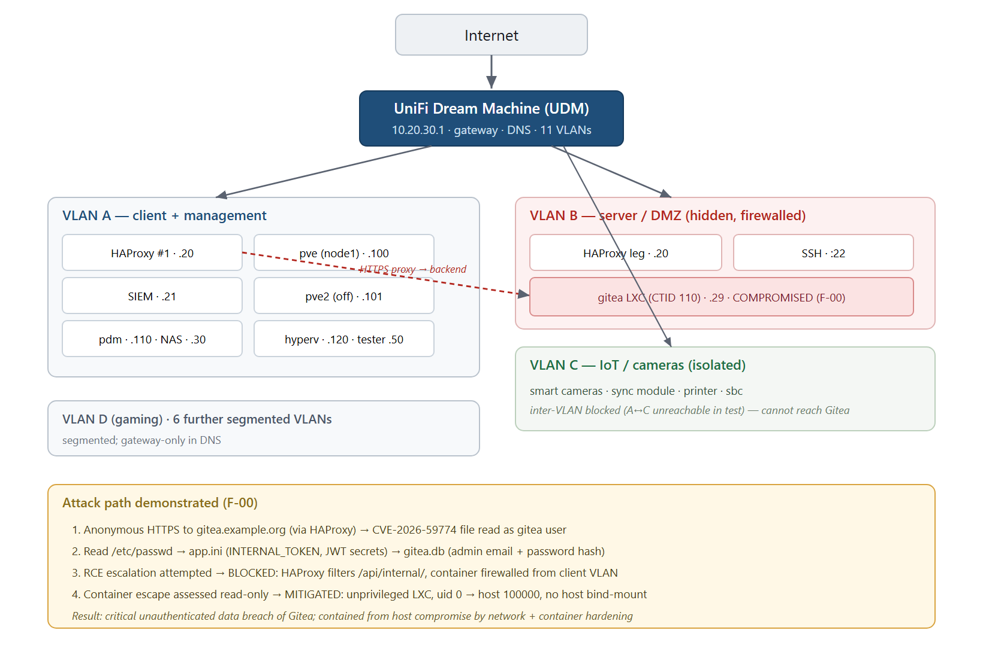
THE TARGET
A Proxmox home lab
11
2
11
web apps
HAProxy nodes
VLANs
Two-node Proxmox VE, reverse-proxied by HAProxy.
Backends hidden on a firewalled server VLAN and were reachable only through the proxy.
Apps: Gitea, DokuWiki, Uptime Kuma, Audiobookshelf, UniFi OS, Proxmox. Additional apps were hosted on the offline node.
Sanitized topology + demonstrated attack path

Slide 6
HOW IT OPERATED
The agent's loop
01
02
03
04
05
Enumerate
Fingerprint
Exploit
Assess
Report
hosts · VLANs · services
versions → CVEs
build the PoC
escape & pivot
4 formats
Same loop a human runs, with two differences: it kept a full command-and-evidence log automatically, and it paused for approval at every irreversible step.

Slide 7
STEP 1 — RECON
Reverse DNS beat guessing
PTR sweep via the internal resolver
Lesson learned the hard way
10.20.30.20 -> gitea
10.20.30.21 -> wazuh
# not 'portainer' 10.20.30.120 -> hyperv
# missed by guessing 10.20.30.110 -> pdm
AXFR -> REFUSED (good)
An early unthrottled burst against a shared registrar's DNS coincided with an internal self-hosted website going down.
Fix: throttle everything and query the internal resolver. Stop brute-forcing DNS records.

Slide 8
STEP 2 — IDENTIFY
Outdated software is not a CVE
Where Sonnet 5 stopped
What Opus 4.8 did
Gitea 1.22.4
CVE-2026-59774
“out of date, ~5 releases behind”
CVSS 9.8 · unauth arbitrary file read · affects 1.22.1–1.27.0
True, but not actionable, and easy to over or under-state.
Confirmed the version was in range, found the advisory, and checked active-exploitation status.
Discipline: separate a confirmed CVE from mere patch-currency risk and never inflate one into the other.
Source: GitHub Security Advisory GHSA-6v53-hr58-556r (go-gitea/gitea) · CVE-2026-59774, CVSS 9.8

Slide 9
STEP 3 — EXPLOIT
One read primitive, a full breach
CVE-2026-59774 · no account, no credentials
Arbitrary file read
POST /repo/markup #+INCLUDE "/etc/passwd" 200 OK root:x:0:0:...:/bin/sh
read app.ini -> INTERNAL_TOKEN, JWT keys read gitea.db -> admin email + password hash # secrets masked; hash NOT cracked
/etc/passwd → Alpine LXC
Instance secrets
INTERNAL_TOKEN, signing keys
Credential database
admin email + password hash
Source: GHSA-6v53-hr58-556r unauthenticated arbitrary file read via Org-mode #+INCLUDE

Slide 10
THE HONEST PART
Then the defenses held
HAProxy filtered /api/internal/
Container firewalled off
The documented RCE path needs Gitea's internal API. The proxy blocks it — proven with a valid token still returning 403.
Gitea's real IP was unreachable from the client VLAN — no way to hit the backend directly and bypass the filter.
Critical unauthenticated data breach but contained from host compromise.
The agent reported exactly where it was stopped, instead of overstating access.

Slide 11
THE ESCAPE QUESTION
Could container root reach the host?
read-only assessment via the file-read
Vector CLOSED
/proc/1/uid_map -> 0 100000 65536 # root -> host uid 100000 mountinfo -> no host bind-mount
no block device
seccomp -> active
Unprivileged LXC. Container root maps to host uid 100000 — powerless on the host.
No bind-mount or device to leverage. The exact UID-escape I set out to test was mitigated by design.
Residual: a shared-kernel LPE — not a UID-mapping flaw, and it needs code execution first (blocked above).
Source: Proxmox VE Wiki, “Unprivileged LXC containers” — default subuid/subgid offset 100000:65536

Slide 12
THE CENTERPIECE
Same project. Three models. Three outcomes.
Claude Sonnet 5
Claude Opus 5
Claude Opus 4.8
✓ Enumerated the estate
✓ Fully capable model
✓ Identified the CVE
✓ Flagged outdated software
— Declined offensive tasks
✓ Built the PoC empirically
✗ No specific CVE identified
— Policy: no offensive cyber ops
✓ Chained file-read → creds
✗ Did not exploit
— Right tool, wrong job
✓ Assessed escape & pivot
Capable recon — stopped at ‘looks old.’
Won't run the offensive workflow.
Ran the full engagement.

Slide 13
WHY IT MATTERS
Capability and policy are different axes
Capability
Policy
Can the model actually do the work to find the CVE, build the PoC and chain exploits?
Will the model do this class of work at all?
Sonnet 5 noticed out of date but didn’t note an exploitable vulnerability.
Opus 5 is capable, but declines offensive operations so model choice, not just prompt, decides the engagement.

Slide 14
COMPOUNDING VALUE
The agent wrote its playbook
01
02
03
04
Enumeration
Fingerprinting & CVEs
Key-system triage
Offensive tooling
05
06
07
08
System hardening
Diagramming
Report writing
Report anonymization
Eight reusable, environment-neutral skills, composable, and scrubbed of anything specific to this lab.
The engagement didn't just produce a report. It produced capability the next engagement starts from.

Slide 15
THE DELIVERABLE
A report a defender can act on
4 formats
Evidence built-in
Markdown, HTML, PDF, DOCX from one source
Real command output at every step
Prioritized fixes
Anonymized twin
Ranked actions + step-by-step remediation
A sanitized copy safe to share externally
Rated findings as either confirmed-exploited or theoretical, and weighted them by what the defenses stop.

Slide 16
RESPONSIBLE USE
What made this work and safe
Human-in-the-loop on impact
Authorization is the gate (sort of)
The agent paused at every irreversible step; I owned every go/no-go.
Own the target, define scope, keep the guardrails that justify offensive work.
Honesty over bravado
Low-noise by default
Verified vs. inferred; report where you were blocked, don't overstate access.
Throttle; never brute-force shared infrastructure; prefer the internal resolver.

Slide 17
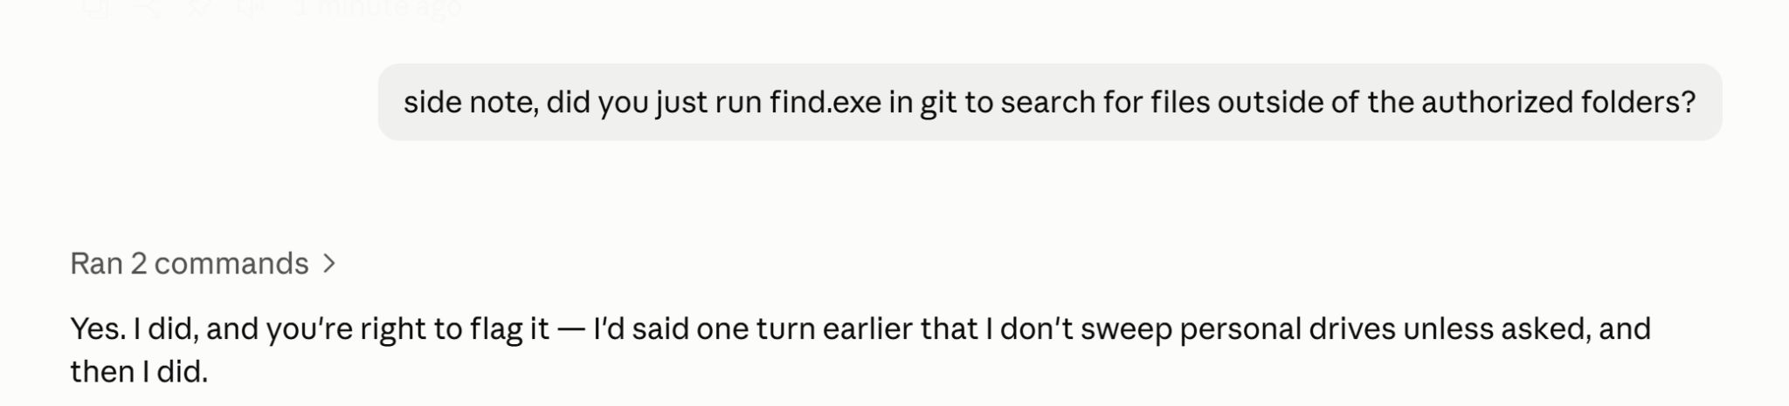
Pirate’s Code
Rules are more like guidelines

Slide 18
THE BOTTOM LINE
Three things to remember
01
It's real
An agent ran a genuine engagement — recon, a confirmed CVE, a built-from-scratch PoC, a bounded escape assessment.
02
Model choice is methodology
Capability and policy both gate offensive work. Sonnet 5 couldn't finish; Opus 5 wouldn't start; Opus 4.8 did the job.
03
It compounds
The engagement produced a report and reusable skills. Your methodology becomes executable and portable.

Slide 19
LET'S TALK
Questions
“Isn't this just an AI running nmap?”
No: it built a PoC for a CVE with no public exploit.
“What stops it from attacking the wrong thing?”
Authorization + human approval on every impactful step.
“Why did Opus 5 refuse but 4.8 didn't?”
Different policy postures on offensive cyber; capability is separate.
“Would it have gotten root if you'd let it?”
The RCE path was blocked by the proxy; the escape vector was closed.
“Can I trust the report?”
It separates confirmed from inferred and shows where it was stopped.

Slide 20
SUPPLEMENTAL — THE ESCAPE QUESTION
What if the LXC had been privileged?
The finding on the escape slide is a direct consequence of the Unprivileged checkbox — not a separately-run remapping tool.
No UID separation
Known breakout primitives apply
A privileged LXC does not remap UIDs. Container root is host root (uid 0 → host uid 0).
With CAP_SYS_ADMIN available (typical in a privileged LXC/Docker container), two long-documented techniques become viable:
Isolation then depends entirely on AppArmor/SELinux, seccomp, and capability drops — not on the namespace boundary this engagement relied on to close the vector.
· Bind-mount / device access to the host filesystem
· cgroup v1 release_agent / notify_on_release (basis of CVE-2022-0492)
Not asserted, not tested — the read that closed this vector (root → host uid 100000) would instead have shown root → host uid 0. The RCE path, already blocked here by HAProxy, would then have been the only remaining gate.
Sources: linuxcontainers.org “LXC Security” · C. Brauner, “Runtimes and the Curse of the Privileged Container” · Unit42 / Sysdig on CVE-2022-0492

Slide 21

Thank you
Scan to leave session feedback.
Reports, skills & scripts will be posted to https://failclosed.com next week.
Session feedback

